Slide 1
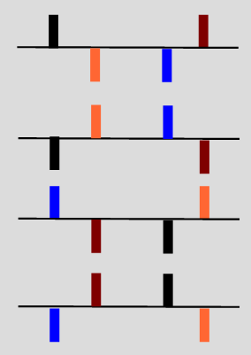
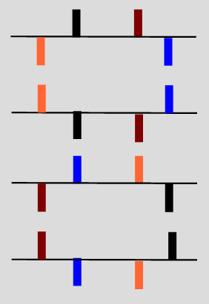
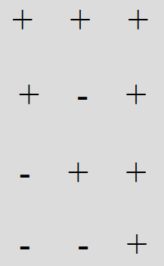
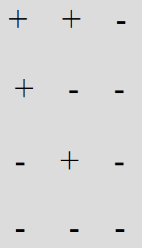








$$J_{13}$$
$$J_{12}$$
$$J_{12}$$
$$J_{13}$$
$$J_{23}$$
$$\text{sign}\left(J_{12}\right)\text{sign}\left(J_{23}\right)2I_{x}^{1}I_{z}^{2}I_{z}^{3}$$
$$J_{23}$$
$$\text{sign}\left(J_{12}\right)\text{sign}\left(J_{23}\right)2I_{x}^{1}I_{z}^{2}I_{z}^{3}$$

